Slide 1
Adoptive Transfer of CD45.1⁺ mature Follicular B cells
Experimental design:
FACS sorting of mature follicular B cells (FoBs; B220⁺, AA4.1⁻, CD23^{high}, CD21^{low}) from CD45.1⁺ C57BL/6J mice
Transfer of ~5x10⁶ FoBs into congenic CD45.2⁺ recipient mice
FACS phenotyping of CD45.1⁺ engrafted wild-type FoBs within a time window of two weeks. We chose day 1 (24h), day 4, and day 14.

Slide 2
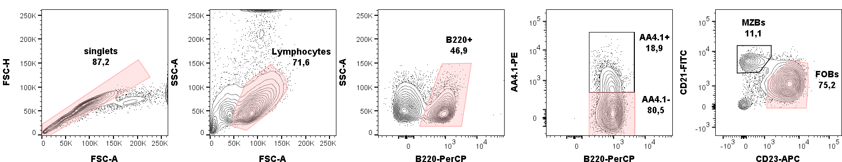
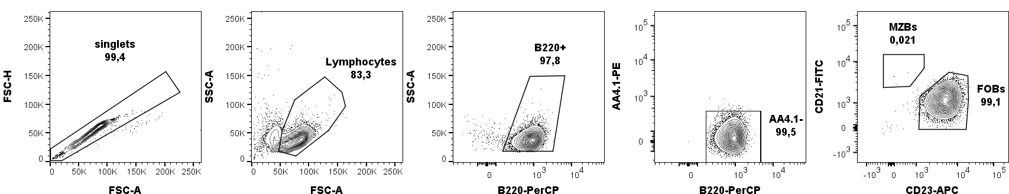
Adoptive Transfer of CD45.1⁺ mature Follicular B cells
Sorting strategy:
A
B
Figure S5: Sorting strategy and purity check of FACS-purified mature follicular B cells for adoptive transfer experiments. (A) The hierarchical gating strategy is highlighted with tinted gates. Note the strict gating within the population of B220⁺, AA4.1⁻ mature B cells on CD23^{high} CD21^{mid} follicular B cells (FOBs) to clearly separate the sorted population from CD23^{low} CD21^{high} marginal zone B cells (MZBs). (B) Re-sort analysis: Gates from (A) were applied to verify purity of sorted follicular B cells before transfer into congenic recipients.

Slide 3
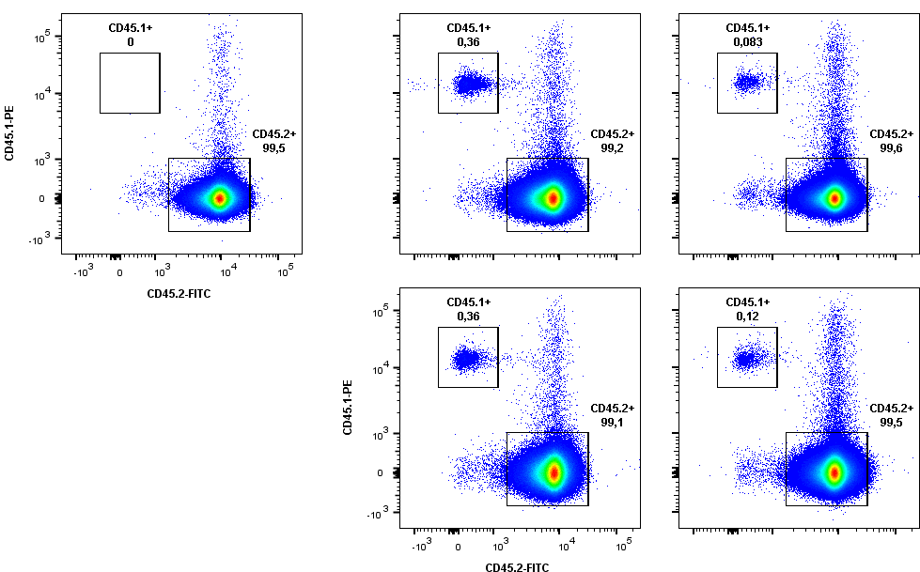
Adoptive Transfer of CD45.1⁺ mature Follicular B cells
Engraftment is low, but the staining for CD45.1 is specific and clean!
Non-transplanted
control
Day 4
Day 14
Representative FACS staining: Analysis of two different transplantations: shown are a non-transplanted, CD45.2 C57BL/6J control animal and two transplanted animals per day after transplantation.
For each day of transplantation, the two animals were transferred the same amount (~5x10⁶) of FACS-purified CD45.1⁺ FoB cells.
Intra-experimental variances are low, but inter-experimental engraftment numbers vary especially for day 14 after transfer.

Slide 4
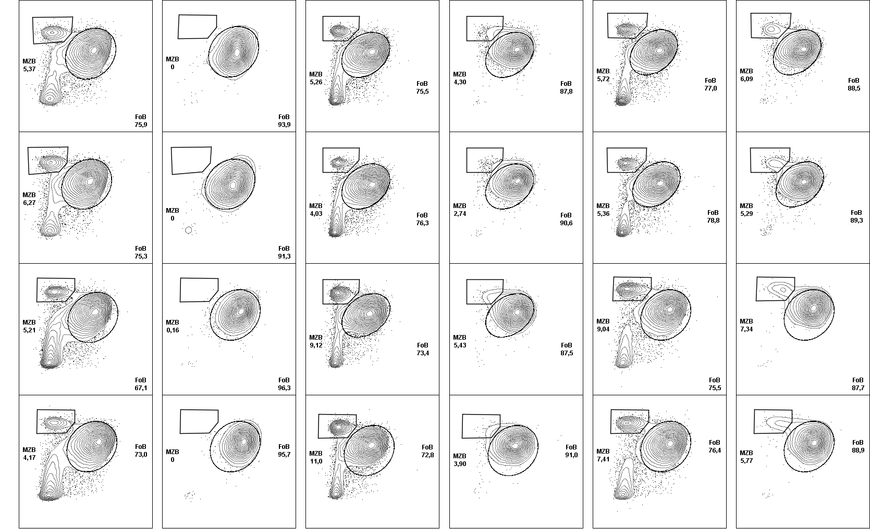
FACS phenotyping of CD45.1⁺ cells over time: CD21/CD23 staining (n=4 recipient mice per time point)
Day 1
Day 4
Day 14
CD45.2
CD45.1
CD45.2
CD45.1
CD45.2
CD45.1
CD21-BV-421
CD23-APC

Slide 5
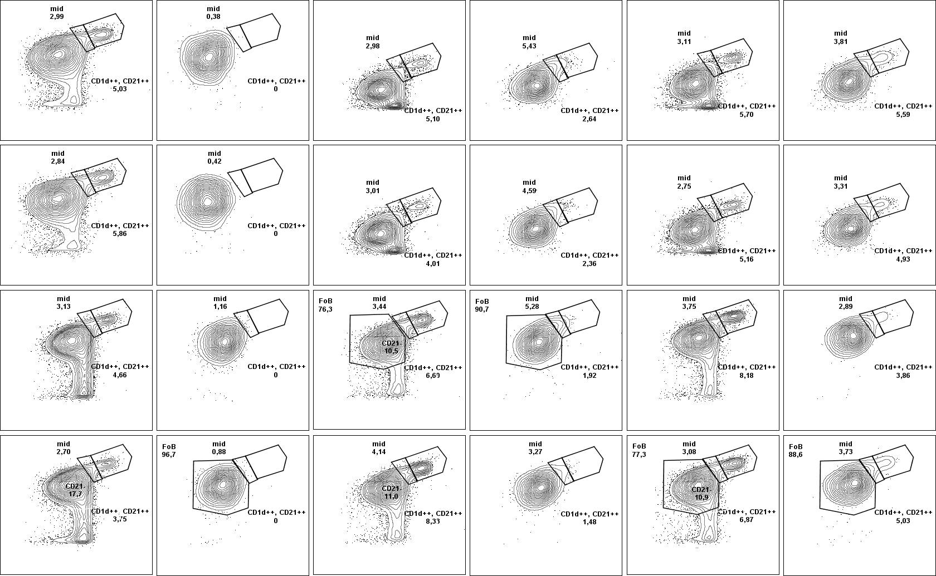
CD21/CD1d staining enables quantification of a CD21^{high} CD1d^{mid} intermediate population (same mice, staining mix2)
Day 1
Day 4
Day 14
CD45.2
CD45.1
CD45.2
CD45.1
CD45.2
CD45.1
CD21-BV-421
CD1d-APC

Slide 6
Quantification of intermediate population and fully trans-differentiated MZBs over time:
*
****
****
*
****
*
CD45.1⁺
CD45.1⁺
Quantification: % intermediates or %MZB from total B220⁺ B cells, pre-gated on either CD45.2 or CD45.1
„Wave“ of transdifferentiation over time? Initial increase in CD45.1⁺ intermediate cells, that then further differentiate to MZBs within between day 4 and 14 after transfer
Data from our RNA Seq showed, that the gene for CD1, Cd1d1, is one of the „late“ MZB genes upregulated during identitiy conversion! (right table).
Good marker for completion of MZB identity
This kinetic nicely fits to CD45.1 phenotypes after transfer.
CD1d surface levels only reach high levels between day 4 and 14
day after Notch2IC induction | fold change
3 | 1,157147
5 | 1,174512
7 | 1,372629
14 | 2,027493

Slide 7
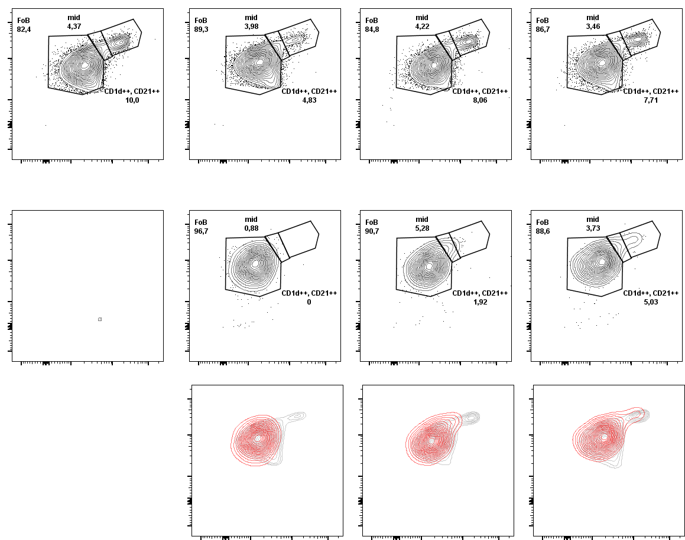
Focus on „intermediates“: additional stainings and overlays
Transplanted animals
Wild type control
Day 1
Day 4
Day 14
CD45.2
CD21-BV-421
CD1d-APC
CD45.1
Overlay
CD45.2
CD45.1

Slide 8
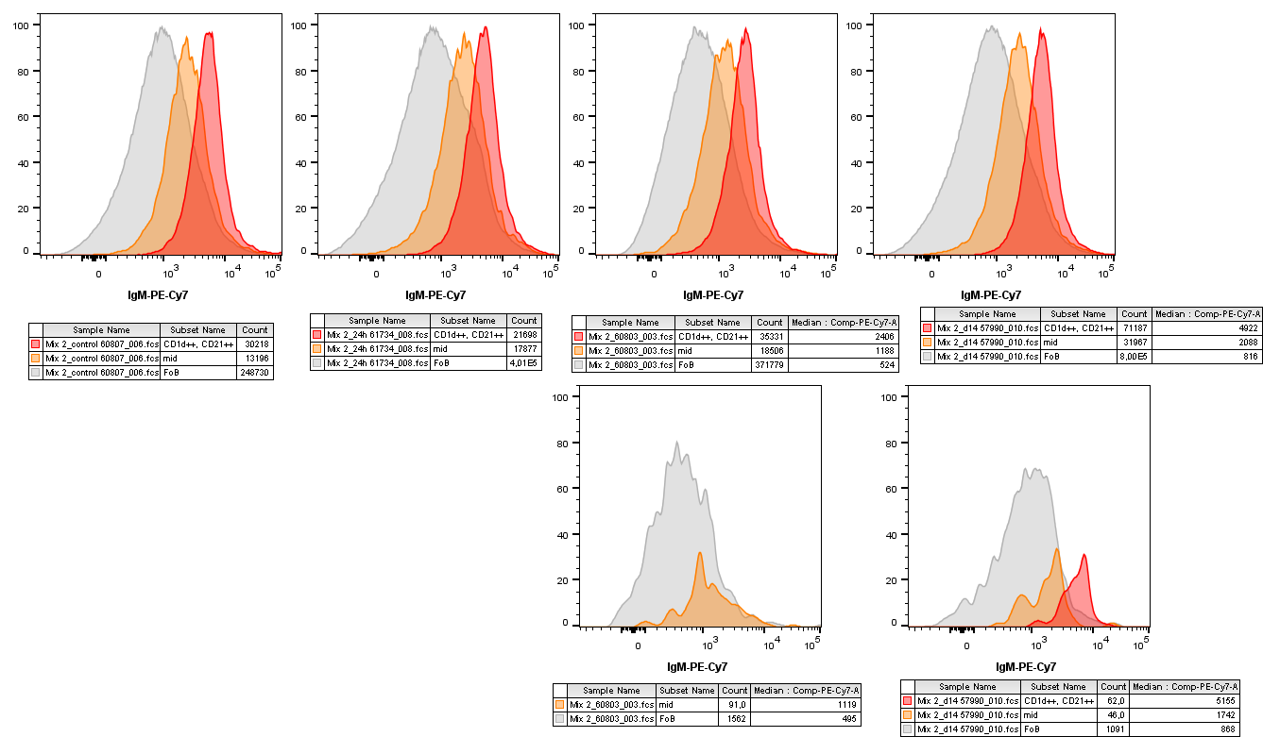
Additional stainings for IgM further illustrates the intermediate identity of CD21^{high}, CD1d^{mid} cells
Gated populations from previous slide, same FACS-staining mix
Transplanted animals
Wild type control
Day 1
Day 4
Day 14
CD45.2
FoB
Intermediates
MZB
CD45.1
Median values show that IgM surface expression levels
from FoBs to intermediats to MZBs increase by factor ~2

Slide 9
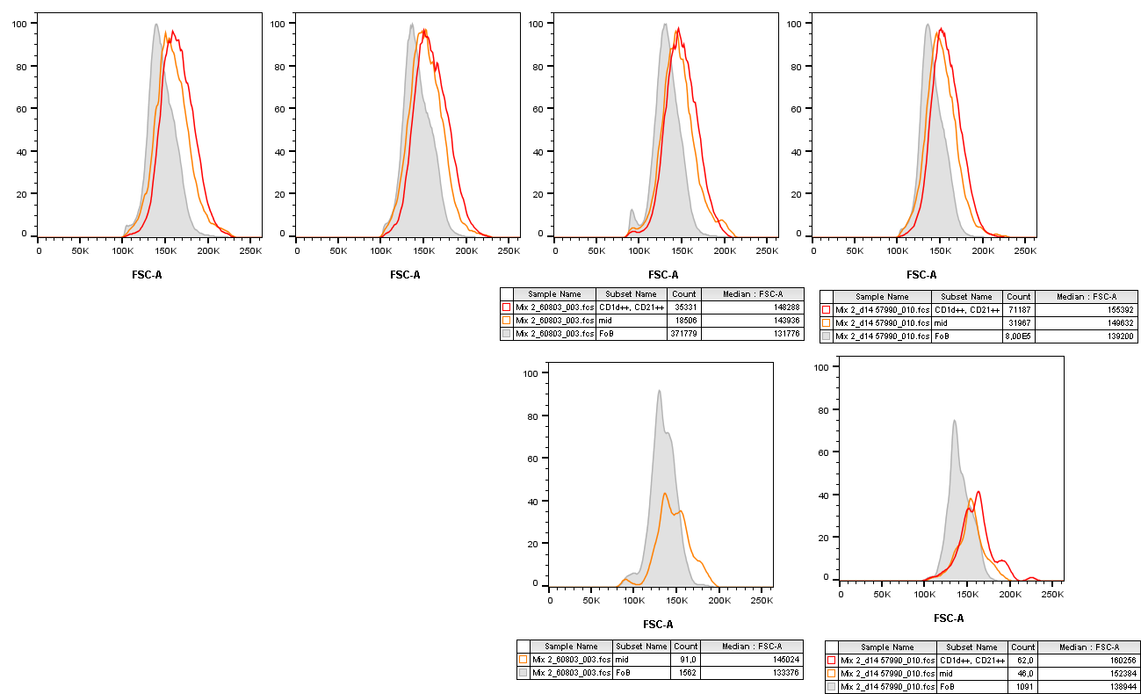
Intermediates and MZBs are also expectably bigger in FSC compared to FoBs
Gated populations from previous slide, same FACS-staining mix
Transplanted animals
Wild type control
Day 1
Day 4
Day 14
CD45.2
FoB
Intermediates
MZB
CD45.1

Slide 10
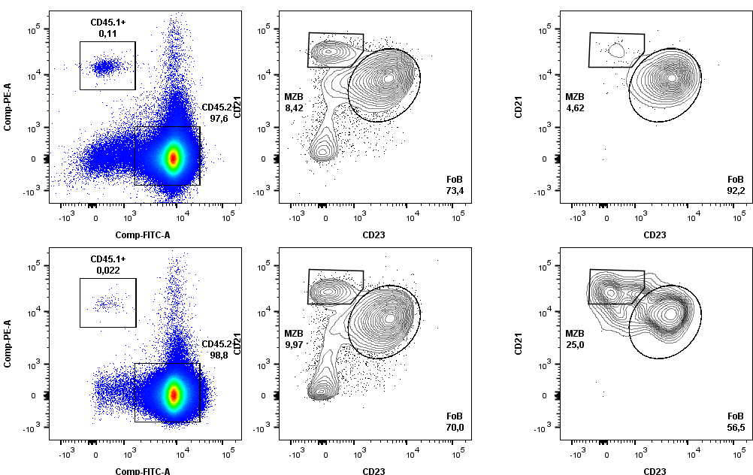
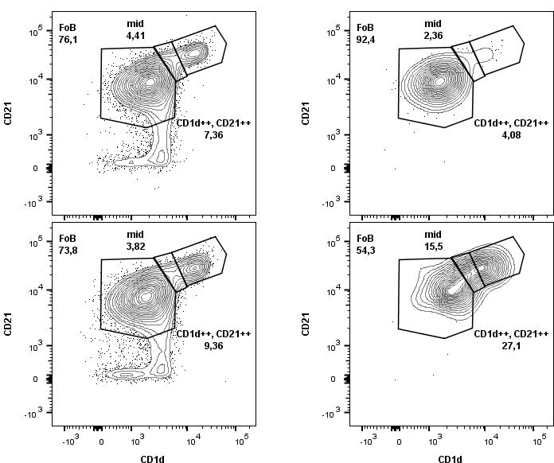
What about the vice-versa situation? Can MZBs trans-differentiate to FoBs?
We tried to address this by also sorting and transplanting MZB cells from the same donor mouse and transplanted in into a sibling of the FoB-recieving mouse.
B220⁺
B220⁺ CD45.2⁺
B220⁺ CD45.1⁺
5*10⁶ CD45.1⁺ FoBs transplanted
1*10⁶ CD45.1⁺ MZBs transplanted
The vice versa situation of phenotypic shift can also be seen after MZB transplantation!
→ will be repeated. If this holds true, this is a massive boulding block for our dynamic plasticity model in mature peripheral B cells!!

Slide 11
Final thoughts on why this exeriment proofs FoB-to-MZB trans-differentiation in a non-transgenic setting
Others have tried this before and possibly failed to detect the conversion because they analysed too early (?)
We knew from Notch2IC-induction experiments, that the intrinsic ability of FoB cells to convert to MZB cells can take up to 2-4 weeks until finished. We therefore chose day 14 after transfer as endpoint of this time series.
Purification of mature FoBs is as clean as it can get. One can never fully rule out the „but this one transplanted MZB ...“-argument, but:
The additional staining of mice for CD45.1 cells 24h after transfer reveals that there is not a single engrafted MZB cell!
if a small number of proliferating MZBs would be responsible for the outgrowth of a MZB population among CD45.1, one would be able to separate a distinct population of fully mature MZBs in the time series, but:
No clearly separate population of CD21high, CD1dhigh, CD23low cells is detectable 4 days after transfer, developing MZBs rather drift from FoB to MZB gates over time.
The gating strategy for CD21^{high}, CD1d^{mid} „intermediates“ is not very elegant, but provides nice options for quantification and analysis for additional marker (IgM, FSC) and nicely illustrates the slow „wave“ of trans-differentiation over a time window of two weeks.
Despite the variance of engrafted cell frequencies at day 14 after transfer (from 0,03% to 0,4%), the proportions of CD45.1⁺ FoB to MZB remain quite stable. This may be hinting on a potential „functional phenotype – equilibrium“ defined by the splenic niches.
The preliminary results of transplanted MZBs strongly support this!

